Slide 1

Creative Innovators

Slide 2
INTRODUCTION
GROUP MEMBERS
Hombisa Dyasi
Tina Qutsu
Malik Malope
Katlego Nnadi
Vuyo
TABLE OF CONTENT.
Introduction to HTML.
Text formatting.
HTML Capabilities.
Navigation and Linking.
Live demo.

Slide 3
Introduction to HTML, CSS AND JS
HTML – It’s a mark up language used to create static web pages and web applications
CSS – It’s a stylesheet language responsible the presentation of the document written in a mark-up language
Js – It allows developer to write codes that perform actions and interact with the user.

Slide 4
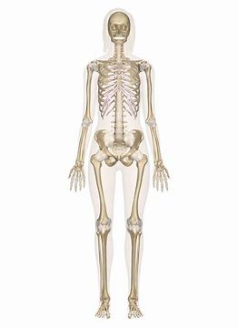

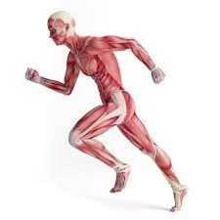
functions of HTML, CSS and JS
css
html
JavaScript

Slide 5
HTML Syntax
Elements – it is a component of an html document that tells a web browser how to structure and interpret a part of html document.
Tags – These are simple instructions that tells a web browser how to format text.

Slide 6
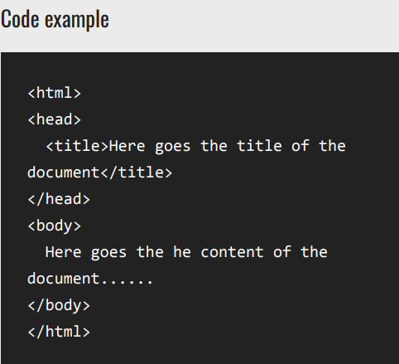
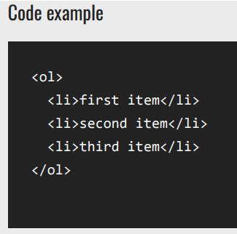
Tags Examples

Slide 7
Trouble shooting & Debugging
Troubleshooting- Refers to the process of identifying and resolving issues or problems within the HTML code or web pages.
Debugging – involves a more specific and technical process of identifying and fixing errors within the code itself, using the browser tools.

Slide 8
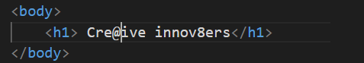
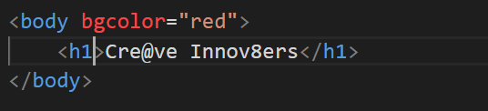
HTML attributes
Attribute – Is a special word or term used to define/modify the characteristics of an element in HTML.

Slide 9
ARIA roles
ARIA – Accessible Rich Internet Applications
They are a set of attributes used in html to make web content more accessible to people with disabilities.
They complement assistive technologies like: -Screen reader
- Screen Magnifier
- Mouse and keyboard

Slide 10
HTML Linking & Navigation
<a> Element
href attribute
URL
<nav> tag

Slide 11
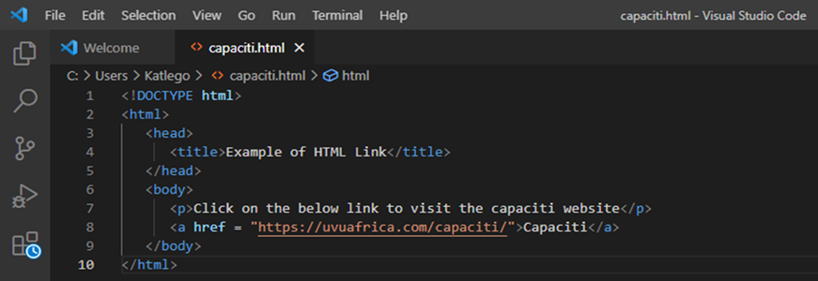
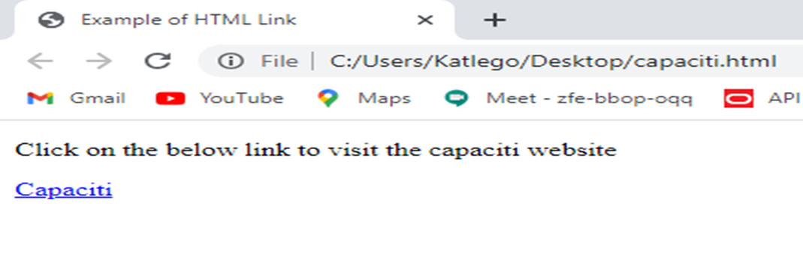
Example of using Links
Code
Output

Slide 12
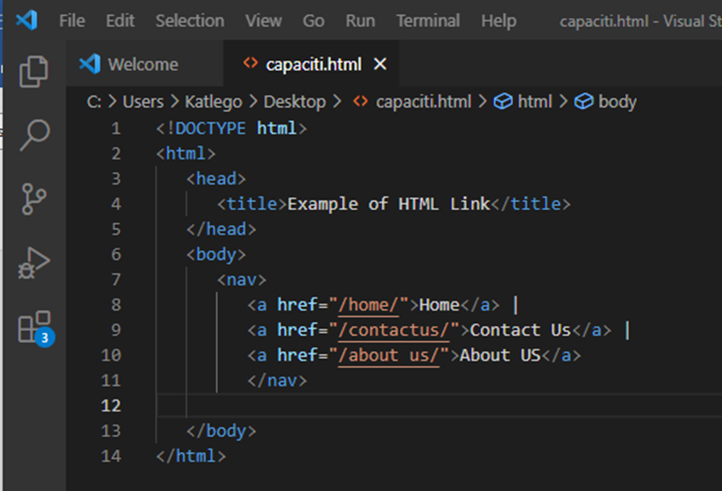
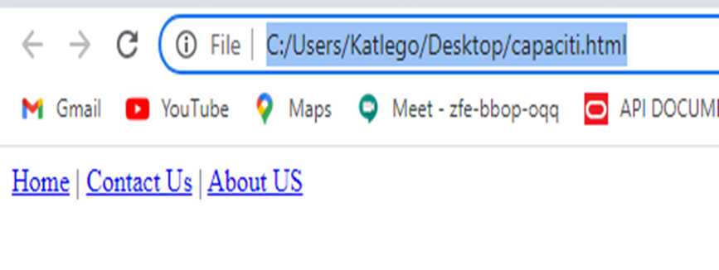
Example of navigation

Slide 13


